Slide 1
OUTLINE
MODULE 1: SESSION 04
DATA STRUCTURES
Data Structures
Classification of Data Structures
Linear Data Structures
Non linear Data Structures
Data Structure Operations
DATA STRUCTURES CLASSIFICATION
1

Slide 2
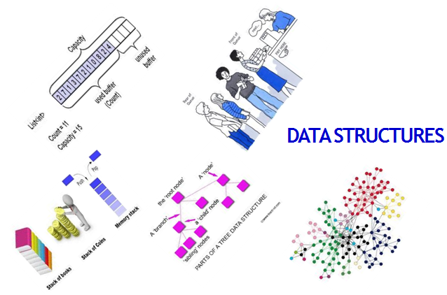
MODULE 1: SESSION 04
DATA STRUCTURES
DATA STRUCTURES CLASSIFICATION
2

Slide 3
MODULE 1: SESSION 04
DATA STRUCTURES
Data may be organized in many different ways; The logical or mathematical model of a particular organization of data is called a DATA STRUCTURE.
The choice of a data model depends on two considerations:
It must be rich enough in structure to mirror the actual relationships of the data in the real world.
The structure should be simple enough that one can effectively process the data when necessary.
DATA STRUCTURES CLASSIFICATION
3

Slide 4
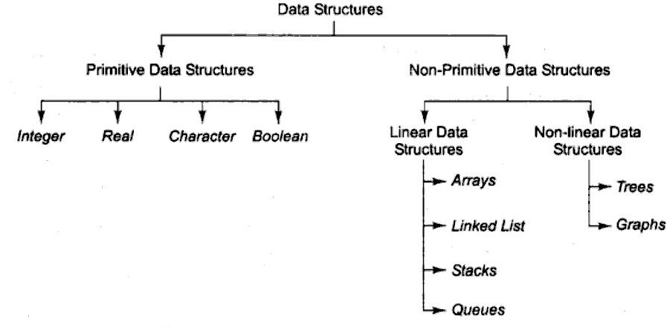
CLASSIFICATION OF DATA STRUCTURES Data structures are mainly classified into primitive and non- primitive data structures.
MODULE 1: SESSION 04
DATA STRUCTURES
DATA STRUCTURES CLASSIFICATION
4

Slide 5
MODULE 1: SESSION 04
DATA STRUCTURES
PRIMITIVE DATA STRUCTURES:
Basic data types such as integer, real, character and boolean are known as primitive data structures. These data types consist of characters that cannot be divided, and hence they are also called simple data types.
NON-PRIMITIVE DATA STRUCTURES:
The simplest example of non-primitive data structure is the processing of complex numbers.
Very few computers are capable of doing arithmetic on complex numbers.
Linked-lists, stacks, queues, trees and graphs are examples of non-primitive data structures.
DATA STRUCTURES CLASSIFICATION
5

Slide 6
Based on the structure and arrangement of data, non- primitive data structures are further classified linear and non- linear. LINEAR DATA STRUCTURES: A data structure is said to be linear if its elements form a sequence or a linear list. In linear data structures, the data is arranged in a linear fashion although the way they are stored in memory need not be sequential. Arrays, lists, stacks and queues are examples of linear data structures.
MODULE 1: SESSION 04
DATA STRUCTURES
ASYMPTOTIC NOTATIONS
6

Slide 7
MODULE 1: SESSION 04
DATA STRUCTURES
NON- LINEAR DATA STRUCTURES:
Conversely, a data structure is said to be non-linear if the data is not arranged in sequence.
The insertion and deletion of data is therefore not possible in a linear fashion.
Trees and graphs are examples of non-linear data structures.
G.PRIYANKA
DATA STRUCTURES CLASSIFICATION 10

Slide 8
MODULE 1: SESSION 04
DATA STRUCTURES
LINEAR DATASTRUCTURES ARRAYS The simplest type of data structure is a linear(one-dimensional) array. LINEAR ARRAY A list of a finite number of ‘n’ of similar data elements referenced respectively by a set of ‘n’ consecutive numbers usually 1,2,3,…n. If the name of the Array is ‘A’, then the elements are denoted by Subscript notation: a₁, a₂, a₃,….a_{n} Paranthesis notation: A(1), A(2), A(3)…. A(N) Bracket notation: A[1], A[2], A[3],…… A[N] Regardless of the notation, the number ‘K’ in A[K] is called a subscript and A[K] is called a subscripted variable.
DATA STRUCTURES CLASSIFICATION 8

Slide 9
LINKED LISTS
MODULE 1: SESSION 04
DATA STRUCTURES
The linked list consists of a series of structures which are not necessarily adjacent in memory.
Each structure contains the element and a pointer to a structure containing its successor.
This pointer is called the “Next” pointer.
The last cell’s next pointer points to NULL.
DATA STRUCTURES CLASSIFICATION 9

Slide 10
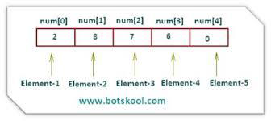

Slide 11
STACK
MODULE 1: SESSION 04
DATA STRUCTURES
It is a Last-In-First-Out (LIFO) system is a linear list in which insertions and deletions can take place only at one end, called the top.
This structure is similar in its operation to a stack of dishes on a spring system.
Example: New dishes are inserted only at the top of the stack and dishes can be deleted only from the top of the stack.
DATA STRUCTURES CLASSIFICATION 11
DR. M. DEVA PRIYA, ASSO. PROF, CSE, SKCT ₁₃

Slide 12
QUEUE
MODULE 1: SESSION 04
DATA STRUCTURES
It is a First-In-First-Out (FIFO) system is a linear list in which deletions can take place only at one end of the list, the “front” of the list, and insertions can take place only at the other end of the list, the “rear” of the list.
Example: A line of people waiting at a bus stop. The first person in line is the first person to board the bus. Another analogy is with automobiles waiting to pass through an intersection – the first car in line is the first car through.

Slide 13
NON LINEAR DATA STRUCTURES
MODULE 1: SESSION 04
DATA STRUCTURES
TREES
Data frequently contain a hierarchical relationship between various elements.
The data structure which reflects this relationship is called a rooted tree graph/ tree.

Slide 14
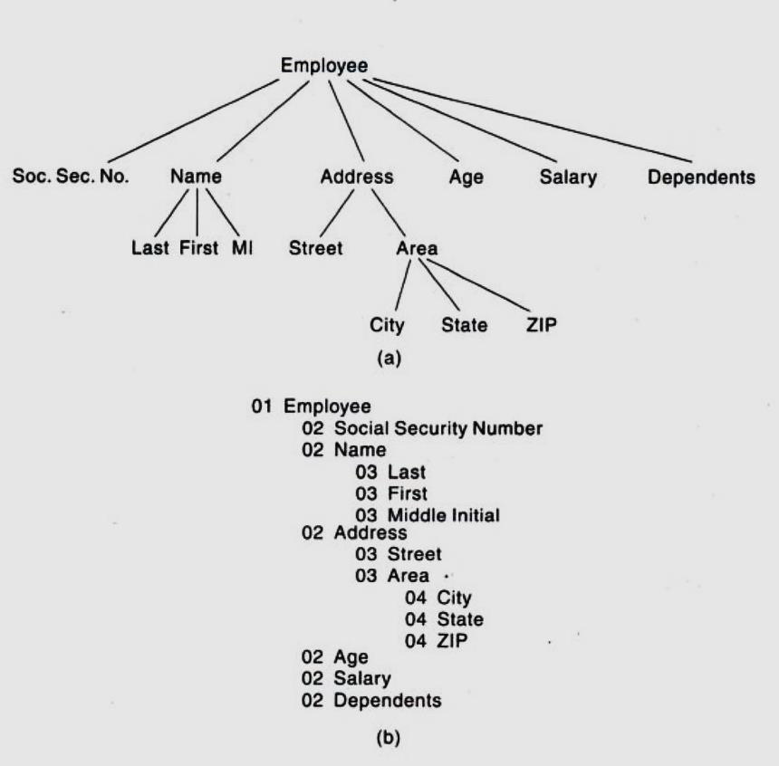
NON LINEAR DATA STRUCTURES TREES
MODULE 1: SESSION 04 DATA STRUCTURES

Slide 15
NON LINEAR DATASTRUCTURES
MODULE 1: SESSION 03
DATA STRUCTURES
GRAPH :
Data sometimes contain a relationship between pairs of elements which is not necessarily hierarchical in nature.
Example: Suppose an airline flies only between the cities connected by lines. The data structure that reflects this type of relationship is called a graph.

Slide 16
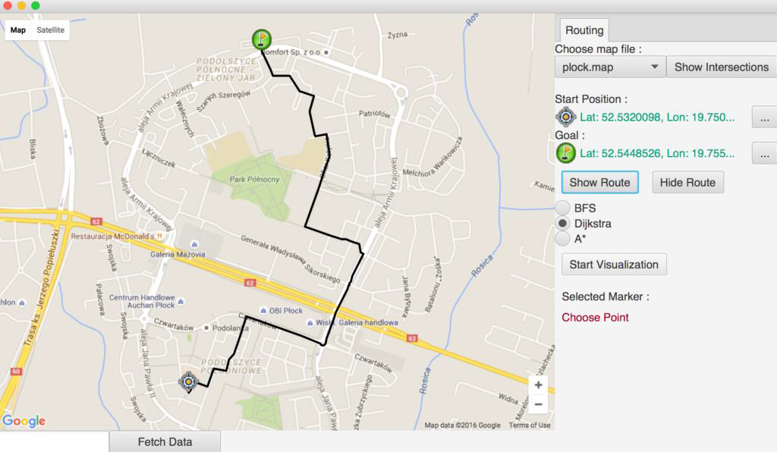
GOOGLE MAP
MODULE 1: SESSION 03
DATA STRUCTURES
G.PRIYANKA
DATA STRUCTURES CLASSIFICATION
16

Slide 17
DATA STRUCTURE OPERATIONS
MODULE 1: SESSION 03
DATA STRUCTURES
The data appearing in data structures are processed by means of certain operations.
In fact, the particular data structure that one chooses for a given situation depends largely on the frequency with which specific operations are performed.

Slide 18
MODULE 1: SESSION 03
DATA STRUCTURES
DATA STRUCTURE OPERATIONS
TRAVERSING (Visiting): Accessing each record exactly once so that certain items in the record may be processed.
SEARCHING: Finding the location of the record with a given key value, or finding the locations of all records which satisfy one or more conditions.
INSERTING: Adding a new record to the structure.
DELETING: Removing a record from the structure.
COMBINATION :Sometimes 2 or more of the operations may be used in a given situation; To delete the record with a given key, search for the location of the record.

Slide 19
MODULE 1: SESSION 03
DATA STRUCTURES
ADDITIONAL OPERATIONS
The operations used in special situations include:
SORTING: Arranging the records in some logical order or in numerical order
MERGING: Combining the records in 2 different sorted files into a single sorted file.

Slide 20
POINTS TO REMEMBER:
MODULE 1: SESSION 03
DATA STRUCTURES
The logical or mathematical model of a particular organization of data is called a DATA STRUCTURE.
Data structures are mainly classified into primitive and non- primitive data structures.
Basic data types such as integer, real, character and boolean are known as primitive data structures.
Linked-lists, stacks, queues, trees and graphs are examples of non-primitive data structures.

Slide 21
MODULE 1: SESSION 03
DATA STRUCTURES
KEY TERMS
Primitive data structures
Non Primitive data structures
Arrays
Linked Lists
Stack
Queue
Trees
Graph

